Slide 1




Comprehensive Guide to
Data Analytics
JSP Team

Slide 2
Topics to be Discussed
1.
Introduction to Data Analytics
5.
DAX Queries
2.
Tools Used in Data Analytics
6.
Power BI & Tableau– Overview
3.
Data Connectors
7.
Power BI vs. Tableau
4.
Dimension & Measure

Slide 3

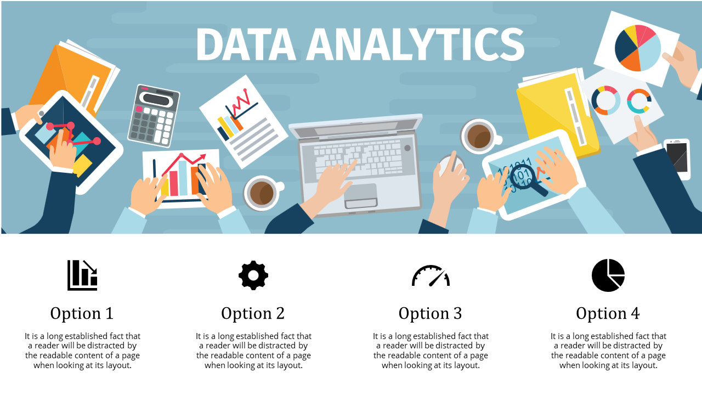




01
Introduction to Data Analytics

Slide 4




02
Data Analytics
Focus
Techniques
Industry Use
Past & present data trends
Predictive modeling & AI
Business strategy & performance
SQL, BI tools
Machine learning, Python, R
Statistical analysis, Excel.
Reporting & dashboards
AI- driven insights
Business decision- making

Slide 5
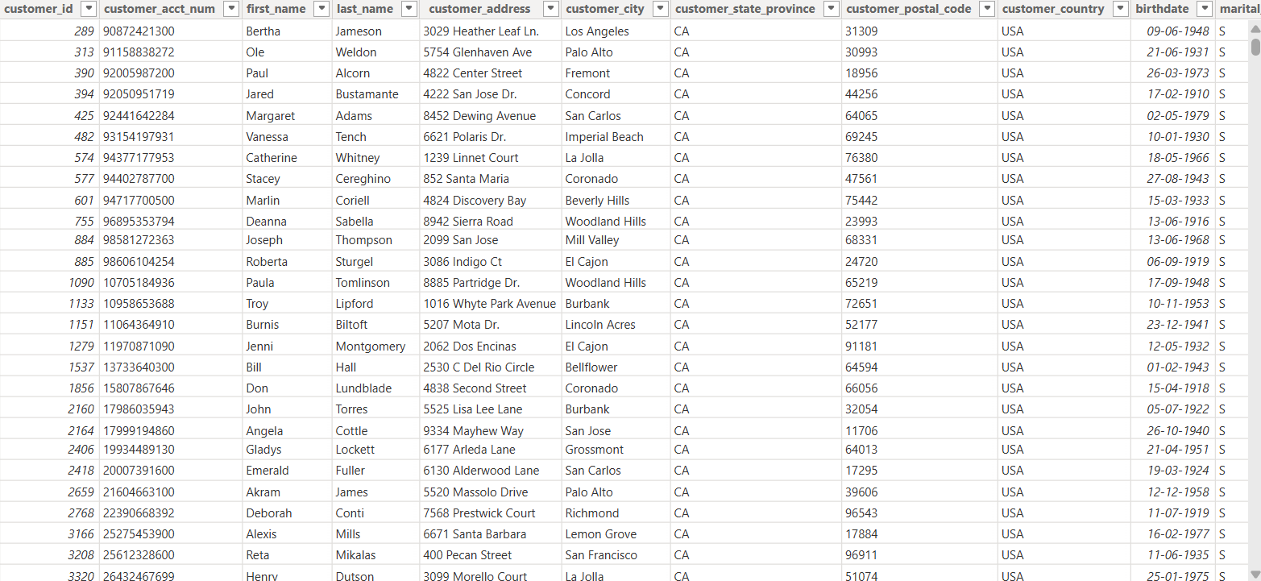
03
Data Table

Slide 6
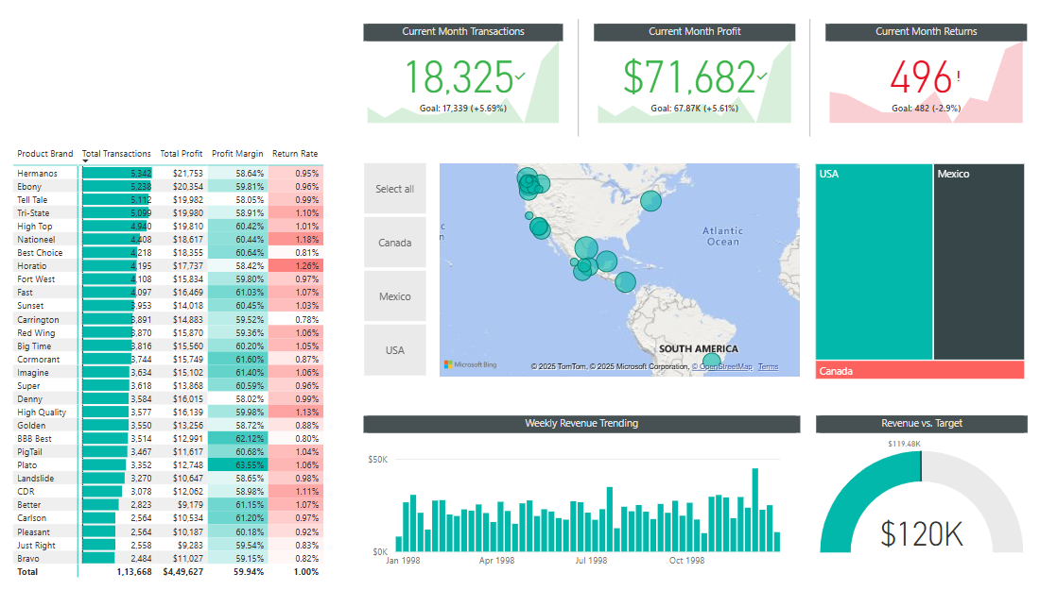
04
DashBoard

Slide 7
05
Data Analyst
vs
Data Scientist
vs
Data Engineer

Slide 8
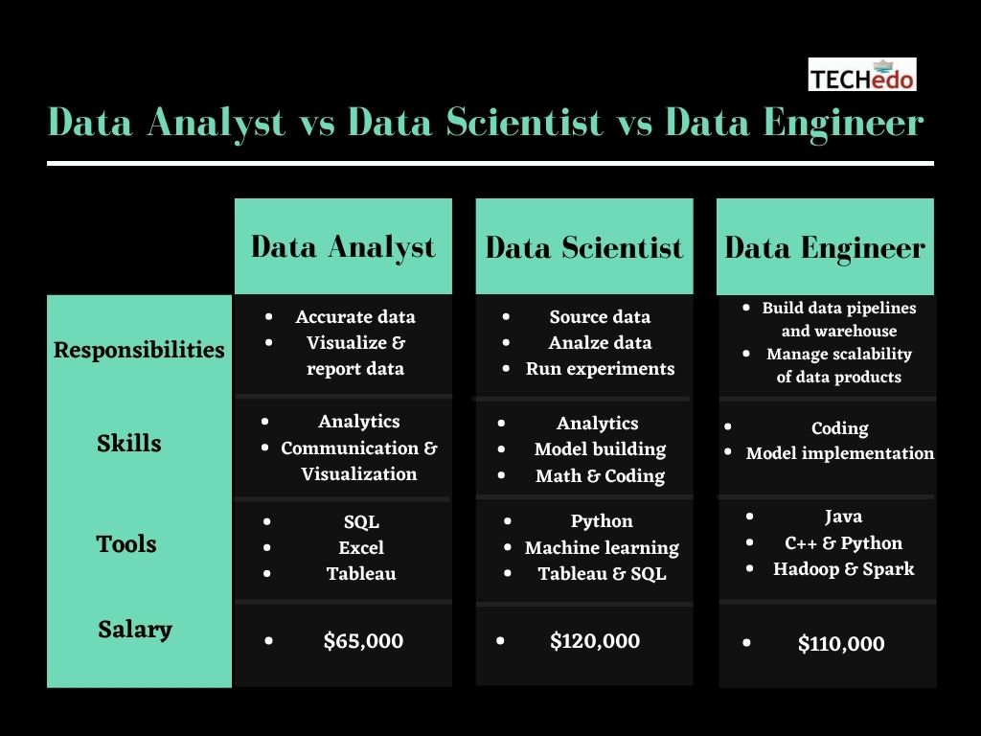
06
Different Roles

Slide 9



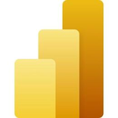






07
Tools Used in Data Analytics
BI & Visualization
Database
Power BI
Tableau
Excel
MySQL
PostgreSQL
MongoDB
Programming Languages
Big Data Platforms
Azure
AWS
SnowFlake
Hadoop
Python
R

Slide 10
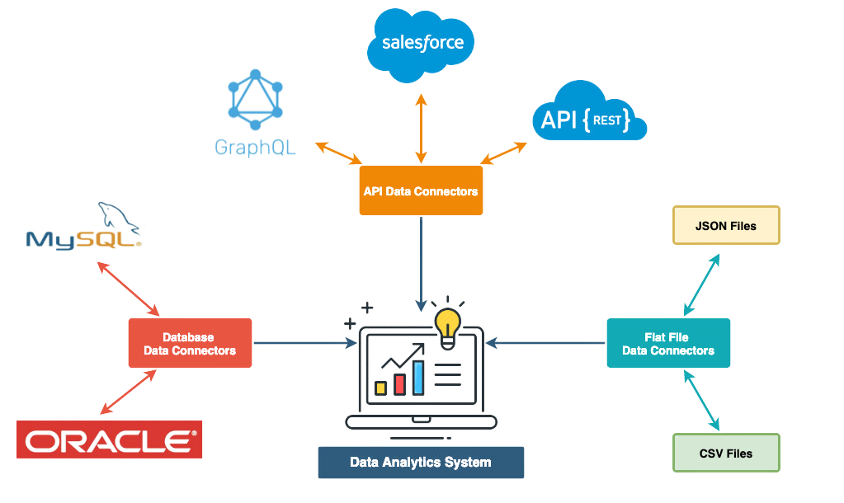
08
Data Connectors

Slide 11
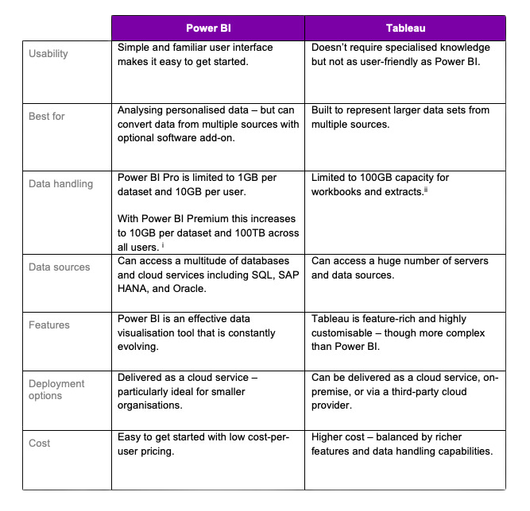
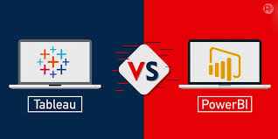
09
Power BI VS Tableau

Slide 12
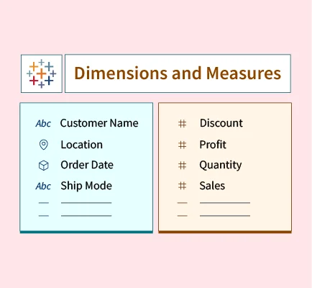
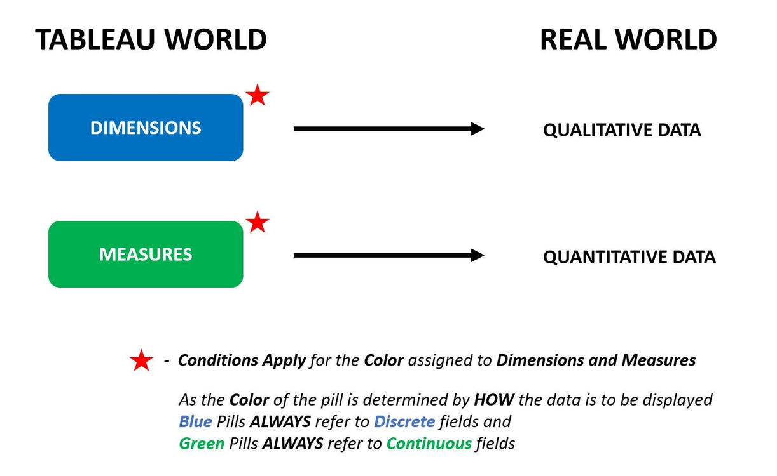
10
Dimension & Measure in Power BI & Tableau

Slide 13
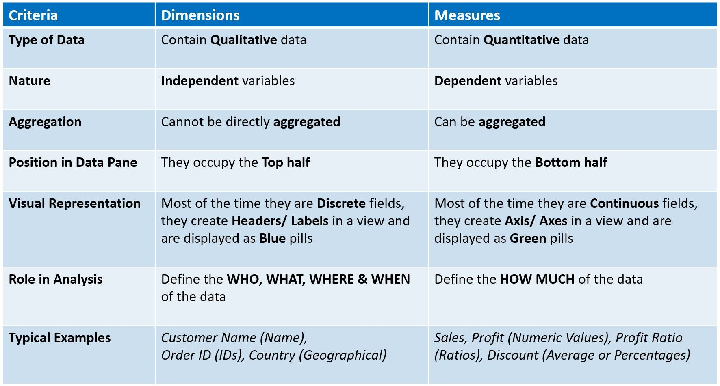
11
07
Tableau Desktop vs. Tableau Services

Slide 14
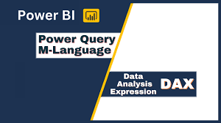
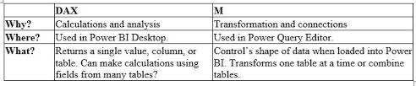
12

Slide 15
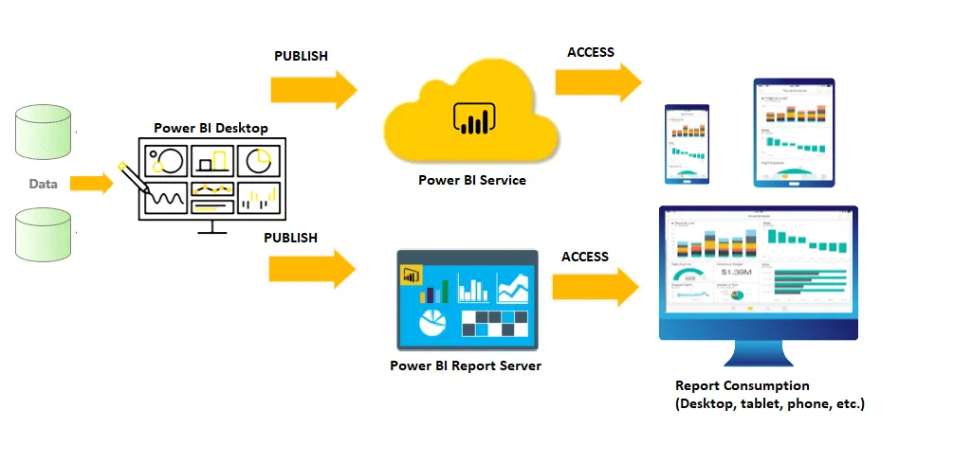
13
Power BI Services

Slide 16
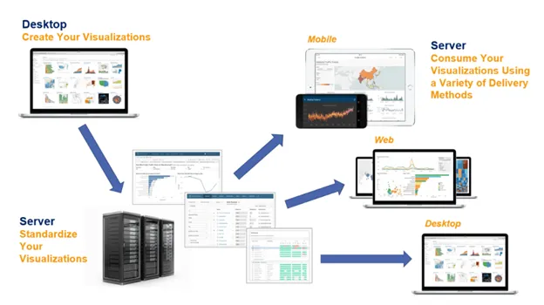

14
Tableau Server

Slide 17
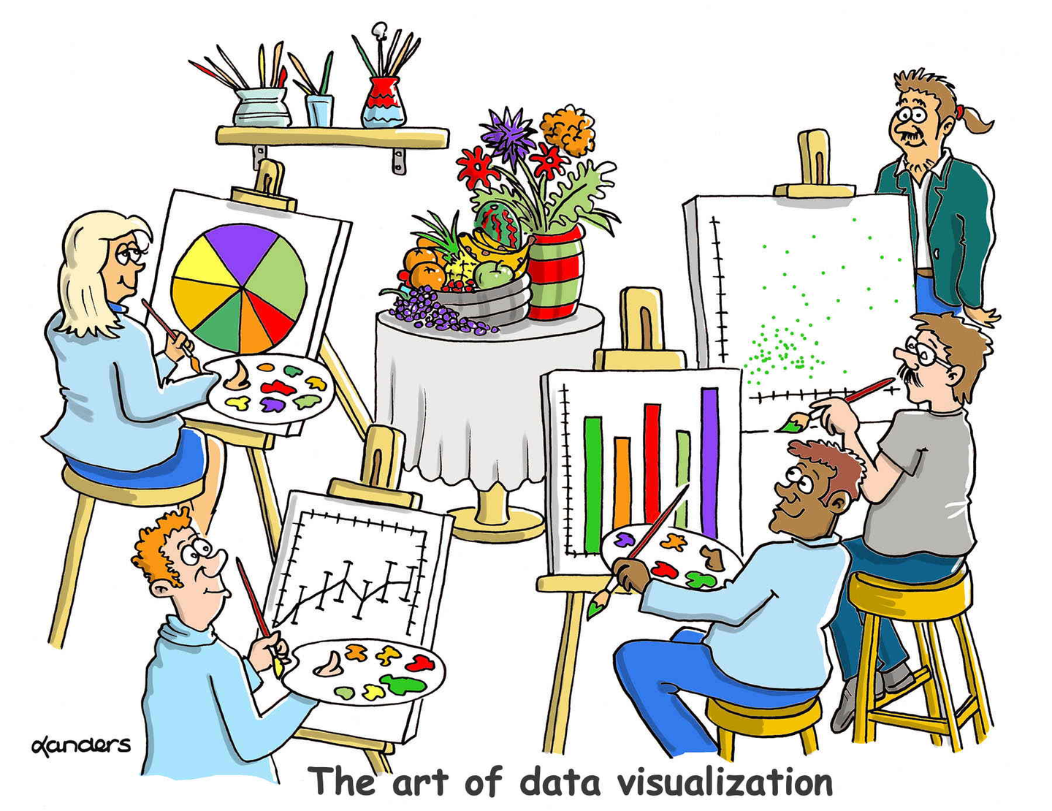


Visualization In Power BI & Tableau
Jagadeesh bro
GAYATHRI
NATESH
ISWAR
NAVIN

Slide 18
Thanks
Edited by LENIN & VELAN

